Slide 1


Getting Started with
New User Training

Slide 2




Agenda
WELCOME
Introductions
About Your Finance Program Plan
How it Works
Get Started
Notes:
[ID:Agenda]

Slide 3


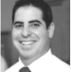
Introductions
Shannon McAulay
Senior Finance Manager
Account Management,
Project Presentation Strategy,
Payment Option / Financing Strategy
Achai Broner, CMVP
Director, Energy Projects
Project Consultations
Energy Efficiency Expertise

Slide 4


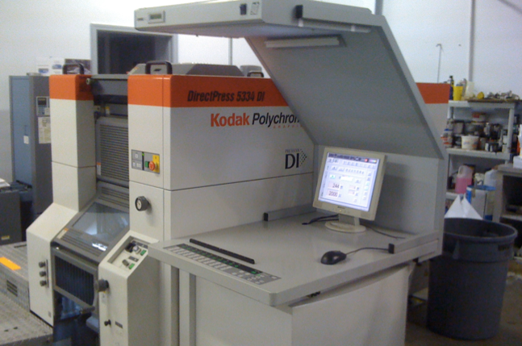

Financing Overcomes the Budget Hurdle
INTRODUCTION
88% of car purchases are financed
80% of home purchases are financed
80% of companies finance capital equipment
With financing I see that I can do this project.
Building Owner
Notes:
As I am sure you know; lack of budget is the number one reason projects and jobs don’t move forward. I assume you have heard that before in your selling, correct? In addition, speaking the economic language of the financial decision maker is also critical since they are the people who hold the purse strings. That is why (X) has decided to partner with Noesis. (X) joins the ranks of companies including HoneyWell, Trane, TD Industries, Daiken and many more who are overcoming these objections in the field.
Providing payment options at every step of your sales process is critical in not only overcoming the biggest objections they have but also giving you a big competitive advantage in the market and makes you a one stop, turn key solution, for your clients.
These building owners finance and use payment options to acquire over 80% of the equipment in their buildings. (Fork lifts, copiers, etc…)Energy related products are no different. Now you can provide them your equipment in a way they are used to paying for it.

Slide 5
Benefits of Financing with Noesis
INTRODUCTION
1
Project sizes from $10,000 to $5 Million+
2
Easy online & paperless application (minutes!)
3
Fast approval process (hours!)
4
100% financing (including installation, other soft costs)
5
No lien on business / property, only equipment
6
Potential Tax benefits
Notes:
[ID:BenefitsOfFinancing]

Slide 6


Case Studies
INTRODUCTION
Equipment Replacement | Energy Efficiency Upgrade
Uptown Baptist Church | Downtown Hotel
Boiler | Chiller with VSD
$56,345 | $223,000
DOWNLOAD CASE STUDY
DOWNLOAD CASE STUDY
Notes:
Add links to Case Studies

Slide 7

Your Finance Program Plan
What is it?
A customized plan of credit products and associated fees.
Who Created it?
In collaboration with the executive sponsor
Why Was it Created?
To match your company’s sales process with Noesis credit products and deliverables

Slide 8
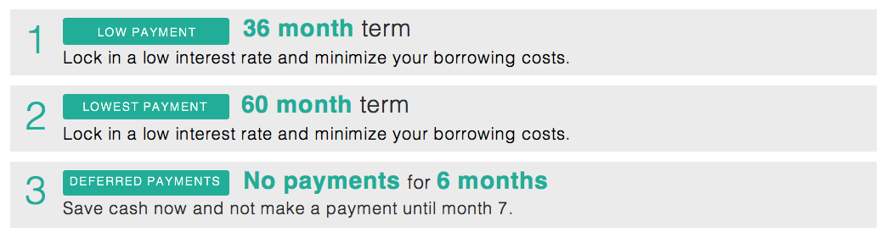
Credit Package 1
FINANCE PROGRAM PLAN
Payment Advantage for Building Equipment
About: Standard equipment financing with market competitive rates
When to Use: Plan/Spec, Cost Already Presented
Fee: 2%
Notes:
Make fees in separate box. Add Icon

Slide 9
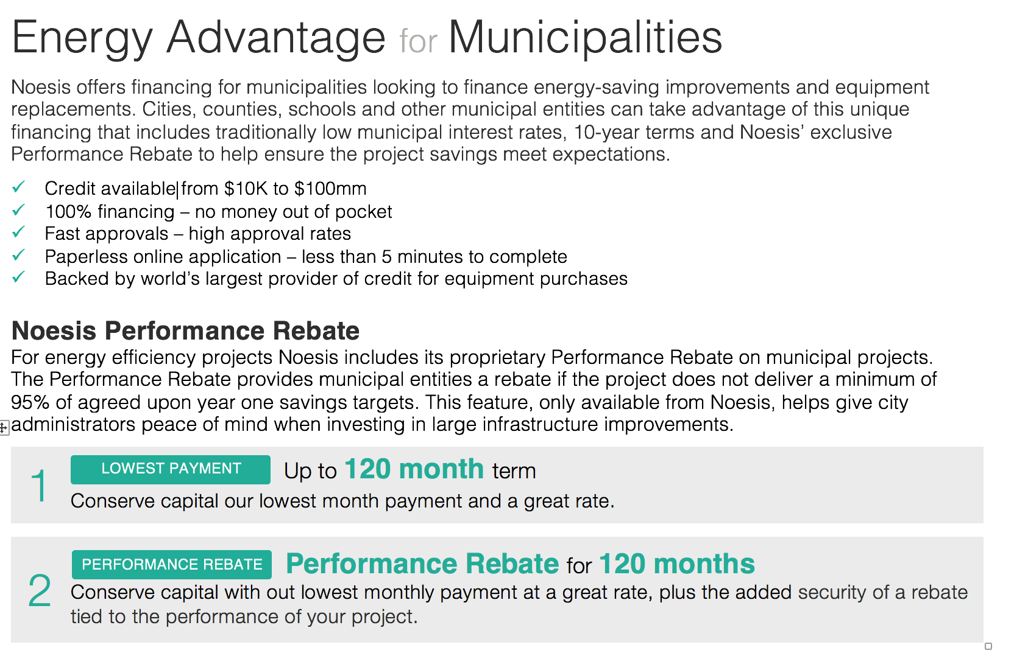
Credit Package 2
FINANCE PROGRAM PLAN
Energy Advantage for Municipalities
About: Tax-exempt financing for Municipal Entities with preferred terms. Credit available from $10,000 to $100 Million.
When to Use: The Noesis Performance Rebate allows you to guarantee savings, we perform third party M&V
Fee: 1.5% Fee w/ Performance Rebate: 5.4%

Slide 10
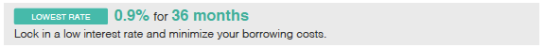
Credit Package 3
FINANCE PROGRAM PLAN
Payment Advantage Plus for Lighting & Controls
About: Promotional Financing Package to Create a Competitive Advantage
When to Use: Pepsi Challenge, Phased vs. Financed, Negotiated Work
Fee: 14.9%

Slide 11
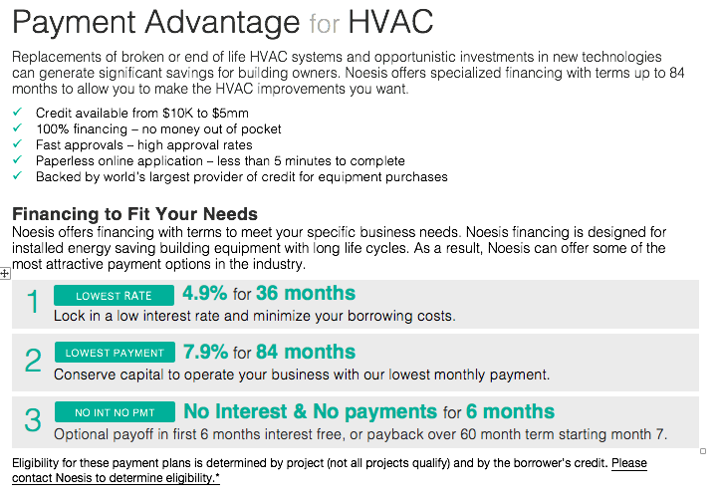
Credit Package 4
FINANCE PROGRAM PLAN
Payment Advantage for HVAC
About: Promotional Financing Package to Create a Competitive Advantage. Longer terms to match HVAC equipment life and paybacks
When to Use: Pepsi Challenge, Phased vs. Financed, Negotiated Work
Fee: 9.9%

Slide 12
Credit Package Fees
FINANCE PROGRAM PLAN
Credit Package | Fee* | When to Use
Building Equipment | 2.0% | Plan/Spec, Cost already presented
Municipalities | 1.5% | Municipal projects with no savings
Municipalities w/ Performance Rebate | 5.4% | Municipal projects with savings
Lighting and Controls Promotional | 9.9% | New Business, Negotiated price
HVAC Promotional | 9.9% | New Business, Negotiated price
*Fees will not be uplifted in platform. Ensure your project has fees built in.
*Fees will be uplifted in platform. Ensure prices on all deliverable match.
Notes:
Edit this slide according to actual packages

Slide 13

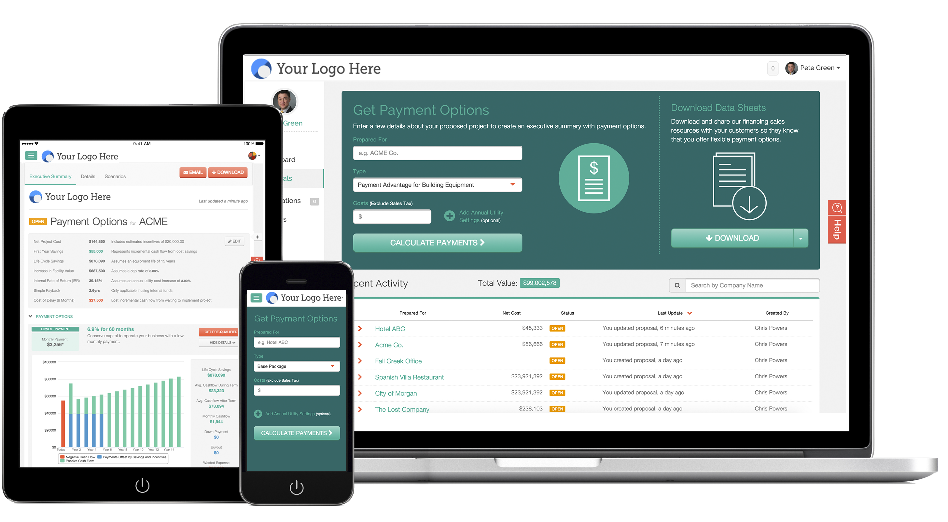
How it Works
Noesis gives you many ways to offer your customer utility savings analysis and monthly payment options. You can now use a smart phone or tablet to estimate monthly payments from your account.

Slide 14
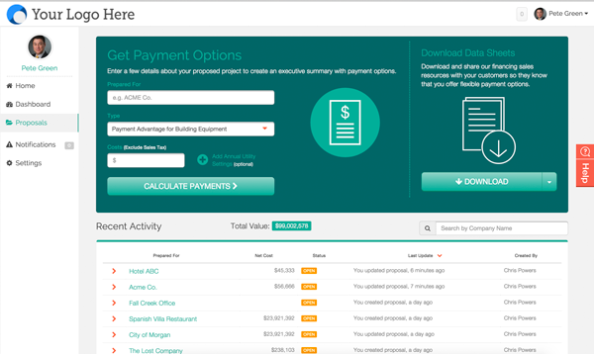
Demo
HOW IT WORKS
In the demo we will walk through the following:
Get Payments Options
Payment Options w/ Utility Savings
Entering Final Costs Once Credit App Submitted
(Click links to watch demo video)

Slide 15
Best Practices for Using Noesis
HOW IT WORKS
Introduce Payment Options early and often
Create payment options for all your Replacement Quotes and EE Proposals
Not just the ones you think need financing
Not just the ones that have energy savings
Not just the ones that are big
Leverage Noesis for financing inquiries – those are buying signals!
Notes:
There are a few best practices here that are critical for you to incorporate.
Almost all financial decision makers want payment options yet very few facility managers understand this.
2. You should introduce that you have a solution to their budget constraints via payment options as early as possible.
3. Don’t wait until they ask you for financing or payment options.
4. ALL your jobs and projects should have payment options attached and one of those options should be your standard terms.
BTW - We have found that introducing payment options early will greatly speed up your sales cycle and increase your win rate. To reward our most active partners and to encourage our new ones to utilize these best practices we have rolled out a $250 spiff for each credit app received from you.

Slide 16
Noesis Q1 2016 Partner Incentive Program
HOW IT WORKS
Effective January 1, 2016 through March 31, 2016, Noesis will be offering
a $150 incentive for each credit application submitted by your prospects.
Notes:
Where did this content come from? Should we put this in the end? Once they know this info

Slide 17


You Present or We Can Help
HOW IT WORKS
You
Noesis Partners regularly present the Economic Business Case and simply refer all financing questions to Noesis
Noesis
You
Your Customer
Noesis has presented EE investment analysis and payment options to over 150 building owners in last 12 months
Notes:
Is there a time you had to sit down with a FDM (or a board of directors) who didn’t understand what a KWH or a BTU was? Or a time they were skeptical on the savings of the project? The Third Party Investment Analysis was designed for that situation. We validate you and the project with our engineering team and present this economic analysis side by side with you to ensure FDM buy in on the project. We do 5-15 of these meetings per week with great success. I encourage you to try this out. It works very well.

Slide 18

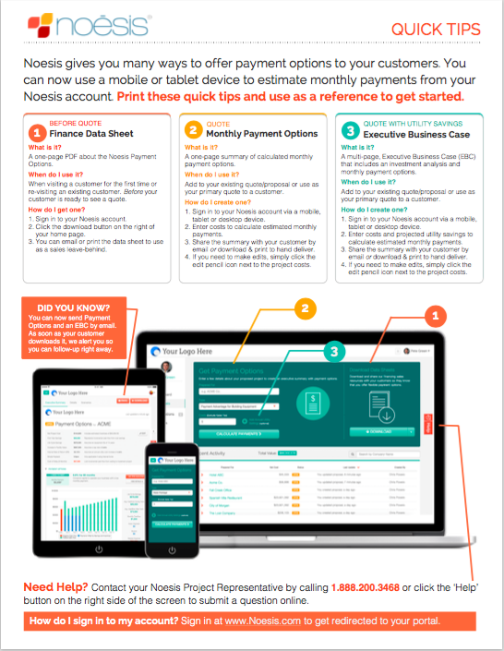
Get Started
Sign in at https://encycle.noesis.com and create your account.
Take a Test Drive – create a practice payment estimate in the platform (30 seconds)
We’ll contact you for a 1:1 tutorial
Financing details
Software features
DOWNLOAD & PRINT QUICK TIPS

